Slide 1
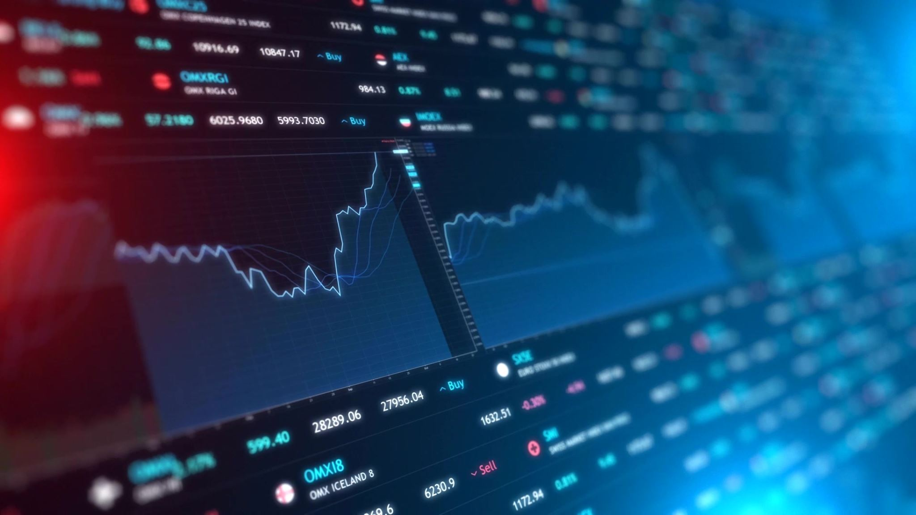
Final Project: JPX Tokyo Stock Exchange Prediction
Elisa Han, Jason Sun, Kevin Wang
CS Insights via Python Programming
Professor Zachary Dodds

Slide 2

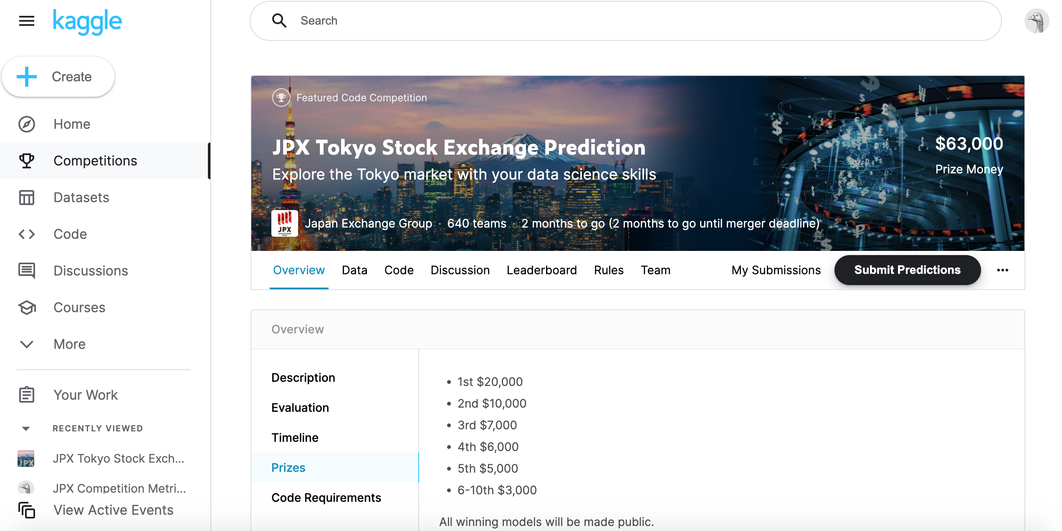
Project Introduction

Slide 3

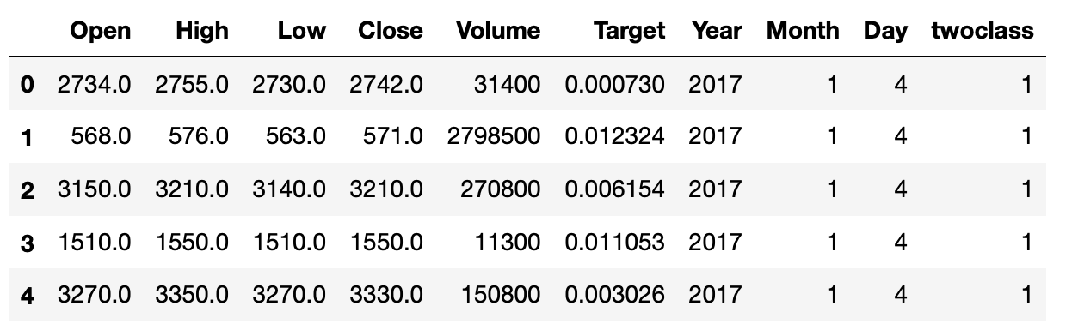
Prediction Problem
Stock information in Day t
Buy in Close price of Day t+1
Sell in Close price of Day t+2
Target = Close price of Day t+1 / Close price of Day t+2
Positive/Negative

Slide 4
Libraries/Data/Progress
Libraries: numpy, pandas, sklearn, flask
Models: KNN, Decision Tree, Random Forest, Neural Networks
Explore the dataset
Use one stock to train and test on other stocks
Use all data to train and test the model with more data
Design the front end page

Slide 5

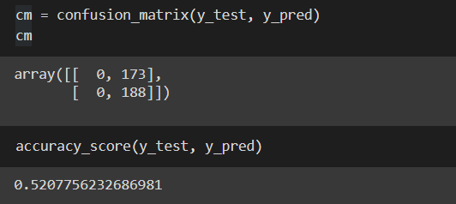
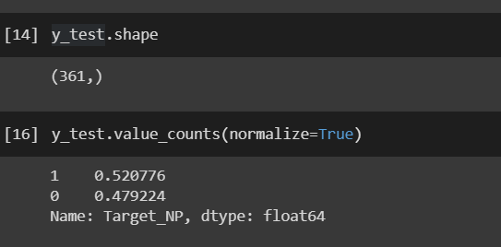
Using only one company to train the model
1202 rows
 | KNN | DT | RF | NN
Accuracy (w/o Date Info.) | 53.46% (K = 21) | 51.80% | 51.52% | 52.08%
Accuracy (w/ Date Info.) | 55.96% (K = 16) | 48.75% | 50.14% | 52.08%
Testing Dataset
Result of Neural Network

Slide 6
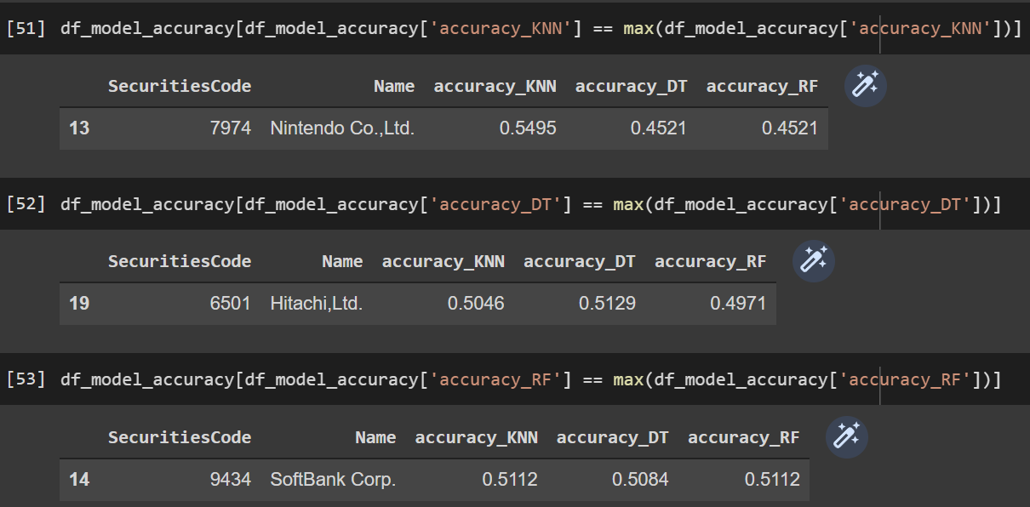
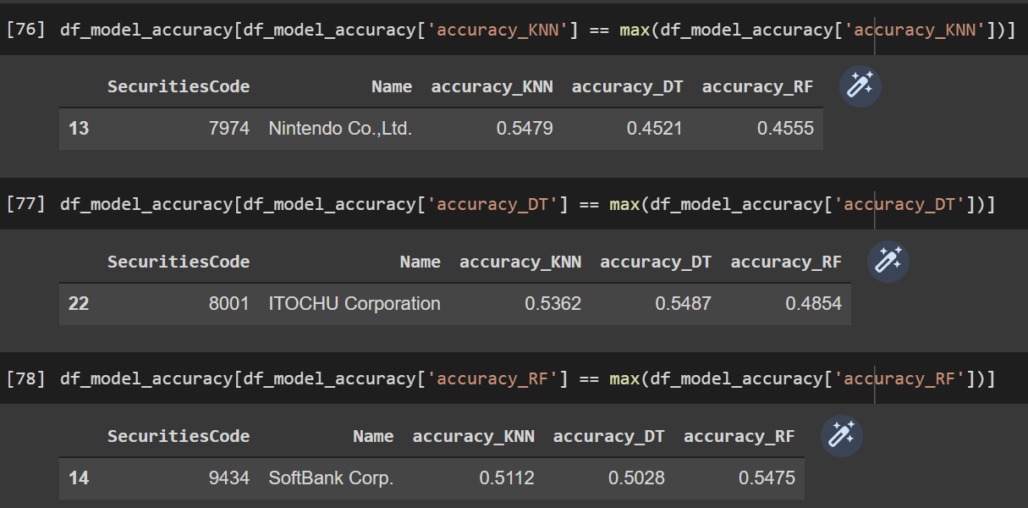
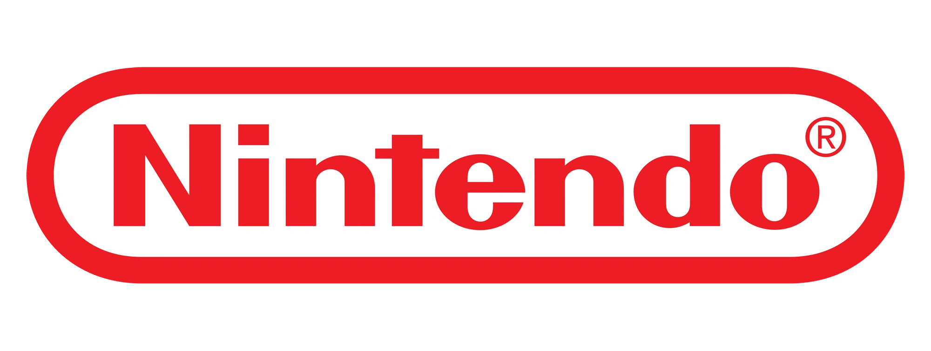


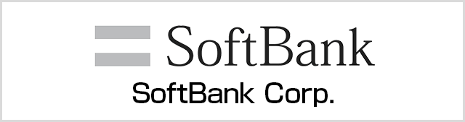
Using the model to do the prediction
The model without date info.
The model with date info.

Slide 7
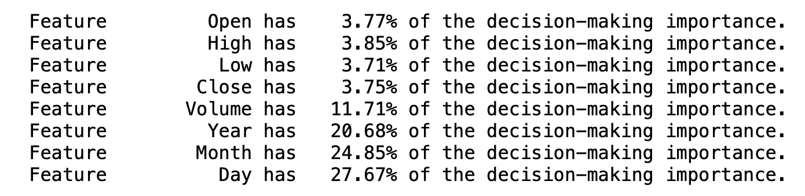
Train on all data
 | KNN | DT | RF | NN
Best Parameters | K = 2 | Depth = 17 | Depth = 6 Trees = 30 | Hidden layers: 16 > 8 > 4
Training | 51.07% | 66.96% | 53.34% | 58.45%
Validation | 51.17% | 67.27% | 53.40% | 58.52%
Testing | 51.87% | 47.15% | 47.15% | 50.87%
Training Data (Jan 4, 2017 – Dec 3, 2021) 80%​
Validation Data (Jan 4, 2017 – Dec 3, 2021) 20%​
Testing Data (Dec 6, 2021 – Feb 28, 2022)

Slide 8
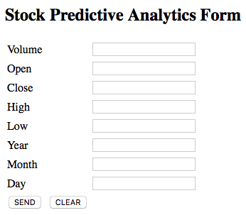
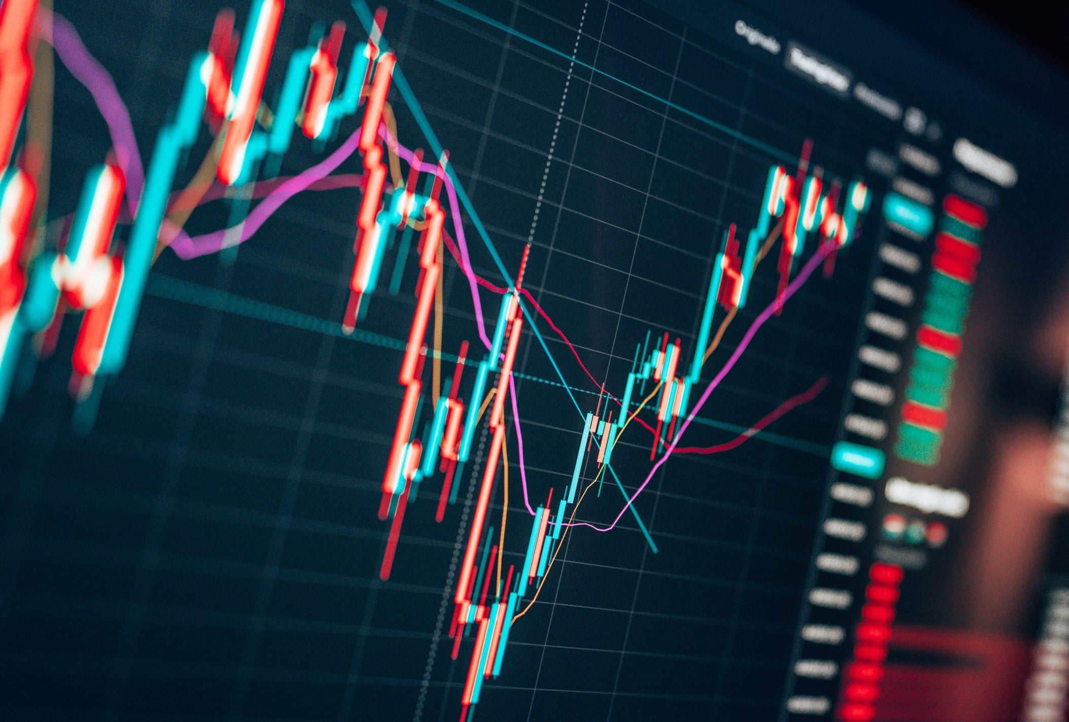
Front-End Interface

Slide 9
Future Plans
Predict multiple classes
Predict the target return value
Consider multiple-day input (like one month)
Train on more 2022 data
Explore random forest with better device
Explore more neural network models
Finish the front end application
Submit the result to the competition

